Slide 1

PathFinder
PathFinder
Chris Costelloe K00233369, Kevin Dunne K00232599, Jekaterina Pavlenko K00224431
Chris Costelloe K00233369, Kevin Dunne K00232599, Jekaterina Pavlenko K00224431

Slide 2
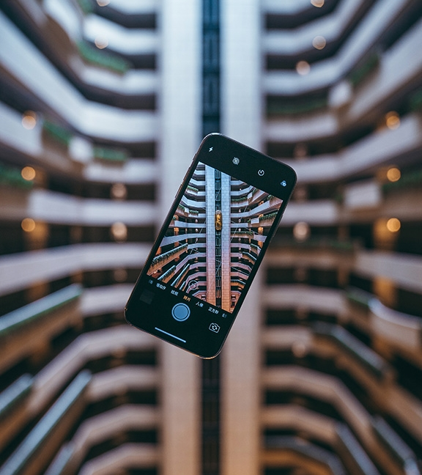
Background
Why we chose this project?

Slide 3
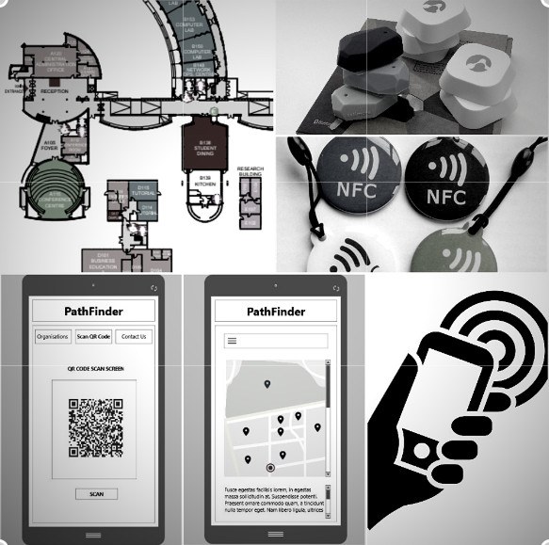
Technologies
List of what we are going to use:
Bluetooth beacons
NFC tags
QR codes
Barcodes

Slide 4
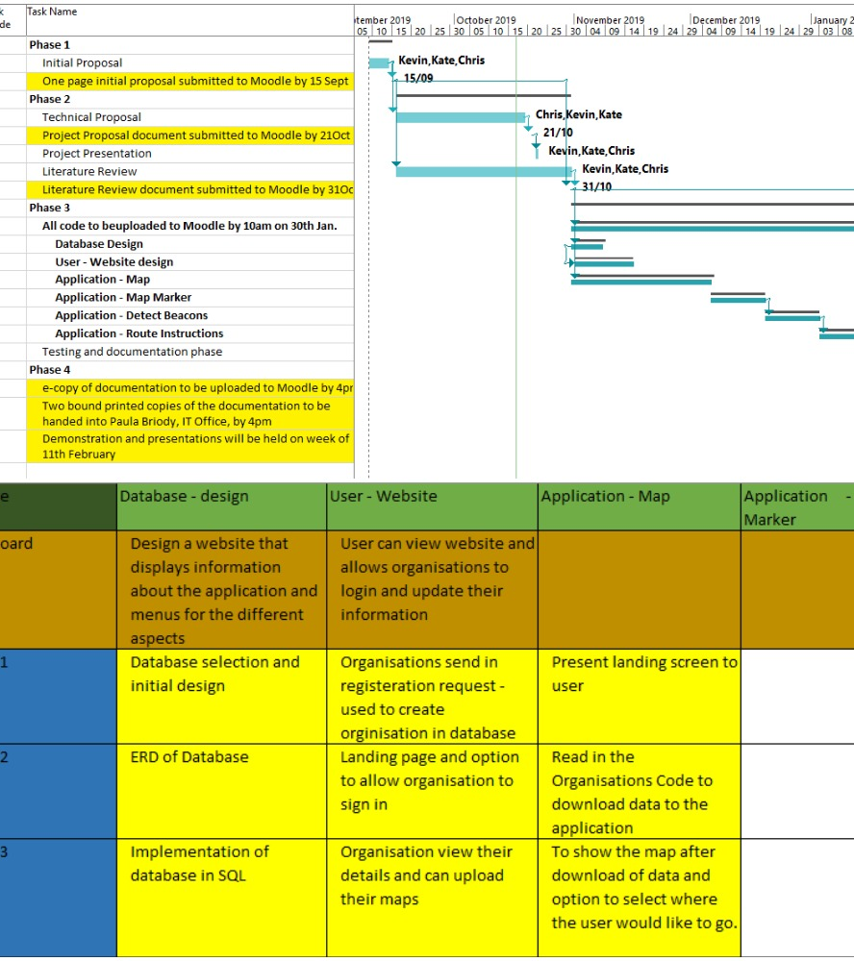
Project Management
Gantt chart & Backlog

Slide 5
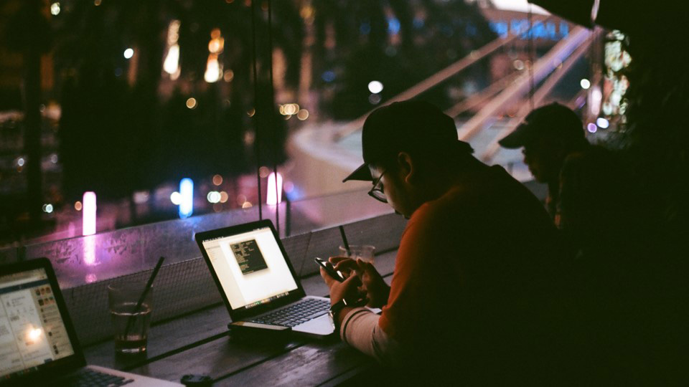
Team Management

Slide 6

THANK YOU

Slide 7
Customize this Template
Template Editing Instructions and Feedback

